Slide 1
Parallel Reachability Testing Based on Hadoop MapReduce
Xiaofang Qi, Yueran Li
School of Computer Science and Engineering, Southeast University
xfqi@seu.edu.cn, lyrsee333@163.com
SATE 2018

Slide 2
Outline
Motivation
Overview of Reachability Testing
Parallel Reachability Testing based on MapReduce
Evaluation

Slide 3
Motivation
Non-deterministic Behaviors of Concurrent Programs
the same input+different schedules → different outputs
Testing Strategies
non-deterministic testing, deterministic testing…
Reachability testing
Executes all partially-ordered synchronization exactly once without saving any test history
Test sequences with exponential complexity
Parallelization may be an ideal way to improve its performance

Slide 4
Contributions
Propose a Parallel Reachability Testing approach (PRT)
Based on MapReduce Framework
A Heuristic Dynamic Load Balancing Strategy.
Implement PRT
An Empirical Evaluation on five concurrent Java programs
Time, speed-up, SRT/PRT

Slide 5
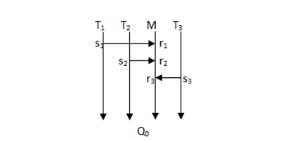
Example for RT
class Rectangle{
private int length, width;
public synchronized void SetL(int length)
{this.length=length;}
public synchronized void SetW(int width)
{this.width=width;}
}
SYN-sequence, a totally ordered sequence of sending and receiving events that occurred on a thread or a synchronization object.

Slide 6
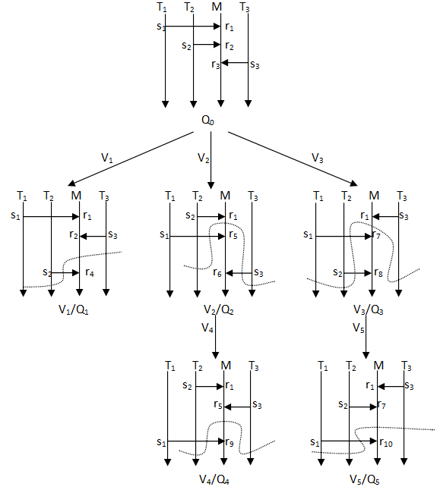

Slide 7
Race
Race betwteen s and s′ w.r.t. r
Q: s→r
Q′: s′→r
Race set: the set of sending events that have a race with s w.r.t r
All the events that happen before s′ or r in Q, and the synchronizations between these events are the same as in Q′

Slide 8
Race Set
race_set(r₁) is {s₂, s₃},
race_set(r₂) is {s₃},
race_set(r₃) is empty.

Slide 9
Race Varaint
A race variant V of a SYN-sequence Q is a prefix of Q by changing the sending event of one or more receiving events in Q .
Constraints:
(1) s′ must be in the race set of r in Q;
(2) an event e in Q must be removed from V if and only if this change will affect the existence of e.

Slide 10
Process of Reachability Testing(RT)
Executes a test run nondeterministically to collect a totally ordered synchronization sequence Q
Generate race variants of Q
Perform a race variant, and proceed nondeterministically
Iterate until no newly generated synchronization sequences

Slide 12
Parallel Reachability Testing(PRT)
Improve the performance of RT
RT is parallelizable
No no synchronization or communication between different synchronization sequences.
MapReduce
Idea of PRT
Use several map tasks to execute race variants in parallel.
Use one reduce task to collect the results.

Slide 13
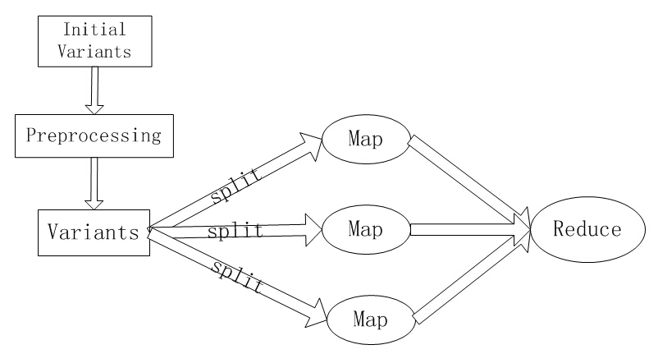
Architecture of PRT
Difficult to predict the number
of descendent sequences of the
initial variants in each map task.
Need a dynamic load balancing strategy
processing

Slide 14
Main Algorithm
PRT(N) {
// N is the iteration number of MapReduce jobs in preprocessing
Variants =GetInitialVariants( );
Variants =Preprocessing(N, variants); //dynamic load balancing
Create a new MRJob2 Job2;
Execute Job2 with Variants as its input;
}
Main Algorithm
GetInitialVariants( ){
Collect a sequence Q₀ by executing CP with input X
2. Variants=GenerateVariants(Q₀);
3. return Variants;
4. }
Initial Race Variants

Slide 15
MRJob1 -- dynamic load balance
Try to minimize the difference in the numbers of the initial variants in each map task in MRJob2 job
Implemented by MRJob1 job
New race variants generated during each iteration,
Iteration times: N
Divide into several equal batches
Each batch is the input data of map task in the next iteration.
Preprocessing(N, Variants){
while(iteration<=N) {
Create a new MRJob1 Job1;
Execute Job1 with Variants as its input;
}
return Variants;
7. }

Slide 16
MRJob1--Map
Map1( ){
let Variants and Sequences be an empty set;
Variants = initial variants from HDFS;
while(Variants is not empty){
withdraw a variant V from Variants;
collect a SYN-sequence Q by conducting a prefix-
based test run with V;
put Q in Sequences;
}
reurn Sequences;
}
Execute Variant, Collect Synchronization sequences
Generate the same key for each SYN-sequence

Slide 17
MRJob1--Reduce
Reduce1( ){
1 let new_variants be an empty set;
while(Sequences is not empty){
withdraw a sequence Q from Sequences;
new_variants=new_variants ∪GenerateVariants(Q);
}
6 divide the new_variants into several equal batches and
write them into HDFS;
}
Generate variants of SYN-Sequences collected in map tasks
Divide them into several equal batches

Slide 18
MRJob2 -- Race Variant Execution
Map2( ){
let Variants and Sequences be an empty set;
Variants = initial variants from HDFS;
while(Variants is not empty) {
withdraw a variant V from Variants;
collect a SYN-sequence Q by conducting a prefix-based test run with V;
6. Variants=Variants∪GenerateVariants(Q);
7. }
8. }
Map: Perform RT until no more new variants are generated
Reduce: Compute the total number of SYN-sequences exercised

Slide 19
Empirical Study
Goal
Evaluate the effectiveness of PRT in terms of the execution time.
Speedup: RT/PRT
Setup
Hadoop cluster of 4 nodes
SRT was executed on one node
PRT was executed by 3 map tasks and 1 reduce task

Slide 20
Subject
RW-SC: a solution to the reader-writer problem using SC monitor for synchronization. RW-SC has 3 readers and 3 writers.
RW-SU: a solution to the reader-writer problem using SU monitors for synchronization. RW-SU has 3 readers and 3 writers .
PC-SC: a solution to the producer-consumer problem where the buffer is protected using SC monitors. PC-SC has 4 producers and 4 consumers and a buffer with 2 slots .
PC-SU: a solution to the producer-consumer problem where the buffer is protected using SU monitor. PC-SU has 6 producers and 5 consumers and a buffer with 2 slots .
Account: Account is a program in Contest benchmark suite. It has 1 bank thread and 5 account threads.

Slide 21
ExecutionTime, Number of SYN-Sequences OF RT
Subject | Time(min) | Num
RW-SC | 2,462 | 2,442,348
RW-SU | 213 | 236,016
PC-SC | 856 | 16,511,040
PC-SU | 1,422 | 39,906,800
Account | 720 | 1,247,400

Slide 22
Execution time(min) and speedup of PRT
Subject | PRT-0 |  | PRT-1 |  | PRT-2 |  | PRT-3
 | T | S | T | S | T | S | T | S
RW-SC | 1,345 | 1.83 | 1,289 | 1.91 | 1,140 | 2.16 | 1,080 | 2.28
RW-SU | 124 | 1.72 | 113 | 1.88 | 101 | 2.10 | 98 | 2.18
PC- SC | 559 | 1.53 | 473 | 1.81 | 440 | 1.95 | 382 | 2.24
PC-SU | 857 | 1.66 | 773 | 1.84 | 687 | 2.07 | 649 | 2.19
Account | 387 | 1.86 | 358 | 2.01 | 344 | 2.09 | 332 | 2.17

Slide 23
Execution time of preprocessing (sec)
Subject | PRT-1 | PRT-2 | PRT-3
RW-SC | 49 | 106 | 341
RW-SU | 40 | 84 | 353
PC-SC | 37 | 82 | 166
PC-SU | 42 | 97 | 179
Account | 41 | 85 | 192
Can ignore the time taken by preprocessing
Improve the initial load unbalance significantly
.
Iteration number should not be too large.
Read all variants into the memory during MRJob1

Slide 24
Conclusions
Present a parallel reachability testing approach based on Hadoop MapReduce (PRT)
a dynamic loading balance with a heuristic strategy
Implement PRT
Evaluation: improve the performance of RT

